Slide 1
CSE 2217 – DSA 2
Lecture 1
Asymptotic Notation
Tahmid Mosaddeque
Department of CSE, UIU

Slide 2
Analyzing Algorithms
Predict the amount of resources required:
  memory: how much space is needed?
  computational time: how fast the algorithm runs?
FACT: running time grows with the size of the input
Input size (number of elements in the input)
  Size of an array, polynomial degree, # of elements in a matrix, # of bits in the binary representation of the input, vertices and edges in a graph
Def: Running time = the number of primitive operations (steps) executed before termination
  Arithmetic operations (+, -, *), data movement, control, decision making (if, while), comparison

Slide 3
Algorithm Complexity
Worst Case Complexity:
  the function defined by the maximum number of steps taken on any instance of size n
Best Case Complexity:
  the function defined by the minimum number of steps taken on any instance of size n
Average Case Complexity:
  the function defined by the average number of steps taken on any instance of size n

Slide 4
Motivation for Asymptotic Analysis
An exact computation of worst-case running time can be difficult
  Function may have many terms:
    4n² - 3n log n + 17.5 n - 43 n^{⅔} + 75
An exact computation of worst-case running time is unnecessary
  Remember that we are already approximating running time by using RAM model

Slide 5
Classifying functions by their
Asymptotic Growth Rates (1/2)
asymptotic growth rate, asymptotic order, or
order of functions
  Comparing and classifying functions that ignores
    constant factors and
    small inputs.
The Sets big oh O(g), big theta Θ(g), big omega Ω(g)

Slide 6
Classifying functions by their
Asymptotic Growth Rates (2/2)
O(g(n)), Big-Oh of g of n, the Asymptotic Upper Bound;
Θ(g(n)), Theta of g of n, the Asymptotic Tight Bound; and
Ω(g(n)), Omega of g of n, the Asymptotic Lower Bound.

Slide 7
Big-O
What does it mean?
  If f(n) = O(n²), then:
    f(n) can be larger than n² sometimes, but…
    We can choose some constant c and some value n₀ such that for every value of n larger than n₀ : f(n) < cn²
    That is, for values larger than n₀, f(n) is never more than a constant multiplier greater than n²
    Or, in other words, f(n) does not grow more than a constant factor faster than n².

Slide 8
Visualization of O(g(n))
cg(n)
f(n)
n₀

Slide 9
Examples
  2n² = O(n³):
  n² = O(n²):
  1000n²+1000n = O(n²):
  n = O(n²):
2n² ≤ cn³ ⇒ 2 ≤ cn ⇒ c = 1 and n₀= 2
n² ≤ cn² ⇒ c ≥ 1 ⇒ c = 1 and n₀= 1
1000n²+1000n ≤ cn² ≤ cn²+ 1000n ⇒ c=1001 and n₀ = 1
n ≤ cn² ⇒ cn ≥ 1 ⇒ c = 1 and n₀= 1

Slide 10
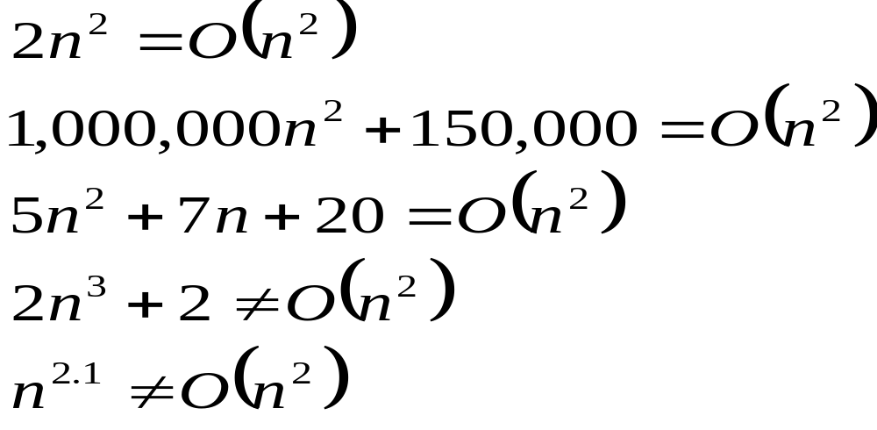
Big-O

Slide 11
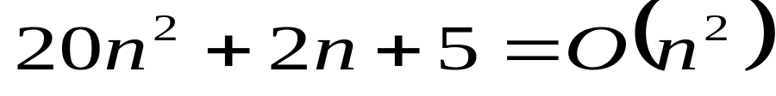
More Big-O
Prove that:
Let c = 21 and n₀ = 4
21n² > 20n² + 2n + 5 for all n > 4
n² > 2n + 5 for all n > 4
TRUE

Slide 12
Tight bounds
We generally want the tightest bound we can find.
While it is true that n² + 7n is in O(n³), it is more interesting to say that it is in O(n²)

Slide 13
Big Omega – Notation
Ω() – A lower bound
  n² = Ω(n)
  Let c = 1, n₀ = 2
  For all n ≥ 2, n² > 1 × n

Slide 14
Visualization of Ω(g(n))
f(n)
cg(n)
n₀

Slide 15
Θ-notation
Big-O is not a tight upper bound. In other words n = O(n²)
Θ provides a tight bound
In other words,

Slide 16
Visualization of Θ(g(n))
c₂g(n)
f(n)
c₁g(n)
n₀

Slide 17
A Few More Examples
n = O(n²) ≠ Θ(n²)
200n² = O(n²) = Θ(n²)
n^{2.5} ≠ O(n²) ≠ Θ(n²)

Slide 18
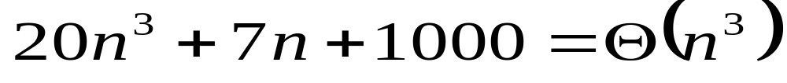
Example 2
Prove that:
Let c = 21 and n₀ = 10
21n³ > 20n³ + 7n + 1000 for all n > 10
n³ > 7n + 5 for all n > 10
TRUE, but we also need…
Let c = 20 and n₀ = 1
20n³ < 20n³ + 7n + 1000 for all n ≥ 1
TRUE

Slide 19

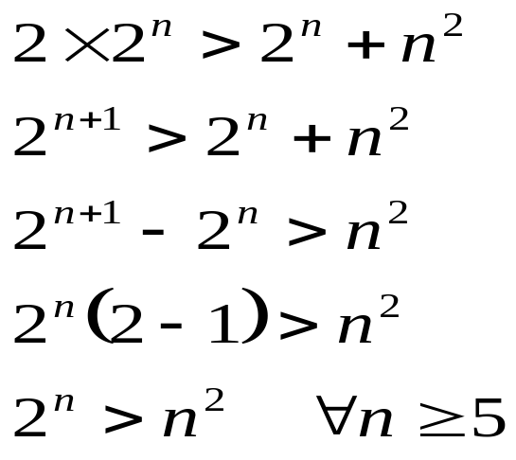
Example 3
Show that
Let c = 2 and n₀ = 5
✓

Slide 20
Asymptotic Notations - Examples
Θ notation
  n²/2 – n/2
  (6n³ + 1)lgn/(n + 1)
  n vs. n²
Ω notation
  n³ vs. n²
  n vs. logn
  n vs. n²
= Θ(n²)
= Θ(n²lgn)
n ≠ Θ(n²)
O notation
  2n² vs. n³
  n² vs. n²
  n³ vs. nlogn
2n² = O(n³)
n³ = Ω(n²)
n² = O(n²)
n = Ω(logn)
n³ ≠ O(nlgn)
n ≠ Ω(n²)

Slide 21
Simplifying Assumptions
1. If f(n) = O(g(n)) and g(n) = O(h(n)), then f(n) = O(h(n))
2. If f(n) = O(kg(n)) for any k > 0, then f(n) = O(g(n))
3. If f₁(n) = O(g₁(n)) and f₂(n) = O(g₂(n)),
then f₁(n) + f₂(n) = O(max (g₁(n), g₂(n)))
4. If f₁(n) = O(g₁(n)) and f₂(n) = O(g₂(n)),
then f₁(n) * f₂(n) = O(g₁(n) * g₂(n))

Slide 22
Example
Code:
a = b;
Complexity:
Notes:
constant

Slide 23
Example
Code:
sum = 0;
for (i=1; i <=n; i++)
sum += n;
Complexity:
Notes:
linear

Slide 24
Example
Code:
sum = 0;
for (j=1; j<=n; j++)
for (i=1; i<=j; i++)
sum++;
for (k=0; k<n; k++)
A[k] = k;
Complexity:
Notes:
N squared == 1 + 2 + … + N

Slide 25
Example
Code:
sum1 = 0;
for (i=1; i<=n; i++)
for (j=1; j<=n; j++)
sum1++;
Complexity:
Notes:
Obviousy n squared

Slide 26
Example
Code:
sum2 = 0;
for (i=1; i<=n; i++)
for (j=1; j<=i; j++)
sum2++;
Complexity:

Slide 27
Example
Code:
sum1 = 0;
for (k=1; k<=n; k*=2)
for (j=1; j<=n; j++)
sum1++;
Complexity:
Notes:
outer loop O(lg N), inner loop (N) == O (N lg N) by product rule

Slide 28
Example
Code:
sum2 = 0;
for (k=1; k<=n; k*=2)
for (j=1; j<=k; j++)
sum2++;
Complexity:
Notes:
outer O (lg N) inner = sum of powers of 2 which is linear since
The sum of powers of 2 dividing into N is 2N so its O (N lg N) by product rule

